Slide 1
V-Model Design
Software Process Model

Slide 2
Introduction
V - Model is an extension of the waterfall model and is based on association of a testing phase for each corresponding development stage.

Slide 3
Introduction
The V-model is also called as Verification and Validation model. The testing activity is perform in the each phase of Software Testing Life Cycle phase.
In the first half of the model verification activity is integrated in each phase like review user requirements, System Design document etc, and
In the next half the Validation testing activity is come in picture.

Slide 4
V-Model design
Under V-Model, the corresponding testing phase of the development phase is planned in parallel.
So there are Verification phases on one side of the V, and
Validation phases on the other side of the V.
Coding phase joins the two sides of the V-Model.

Slide 5
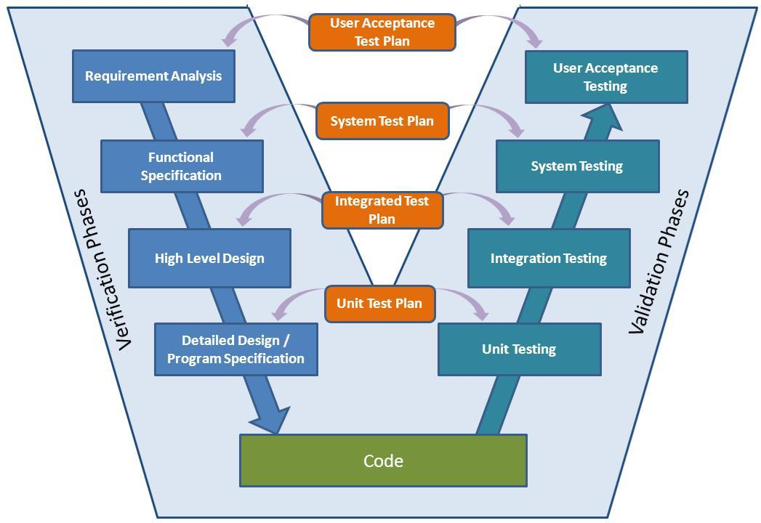

Slide 6
Benefits
Fault Multiplication can be reduced
Improved quality and reliability
Reduction in the amount of Re-work.
Improved Risk-Management System
Verification and Validation at each level of stage containment
Developing critical knowledge and confidence in the initial stages

Slide 7
Disadvantages
Lot of money and resources are required
Very rigid and less flexible
Suitable for long term/ large projects
Ignorance of any of the test phases may lead to poor quality
No software prototype available
Any modifications, then the test documents along with the requirement documents has to be updated

Slide 8
Thanks

